Slide 1

The Honours System
Nicki Daniels, Head of Honours Operations, the Cabinet Office
Lisa Opie - member of the Arts and Media Honours Committee
Jennie Price CBE - member of the Sport Honours Committee
Notes:
Very pleased to be here today to talk about the Honours Sytem. Delighted to be joined by two committee members who you will hear from a little later.

Slide 2
Agenda
The UK Honours System
The Honours process
Writing a citation and what makes a good nomination
Questions

Slide 3
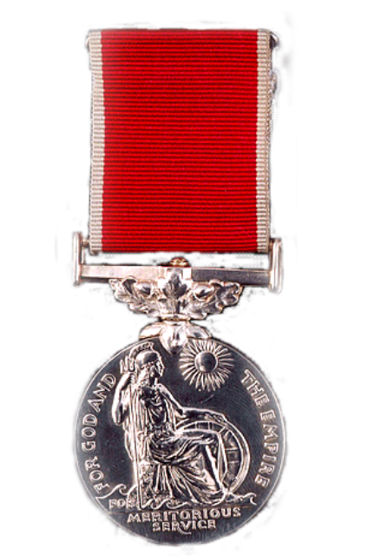
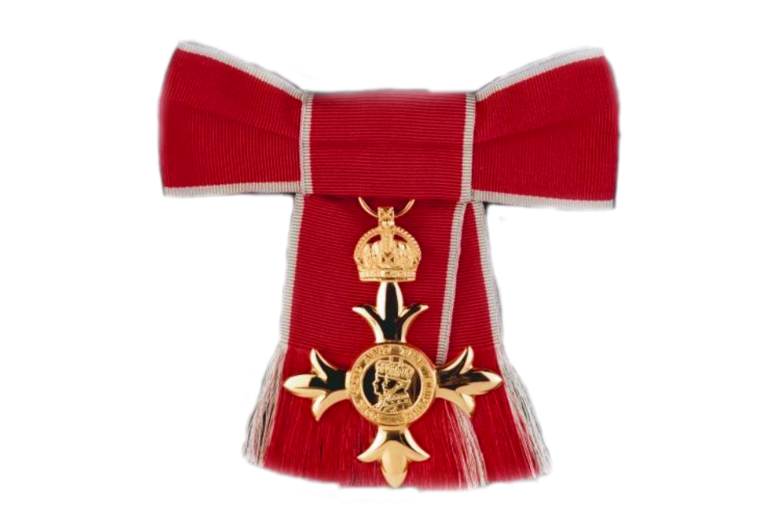
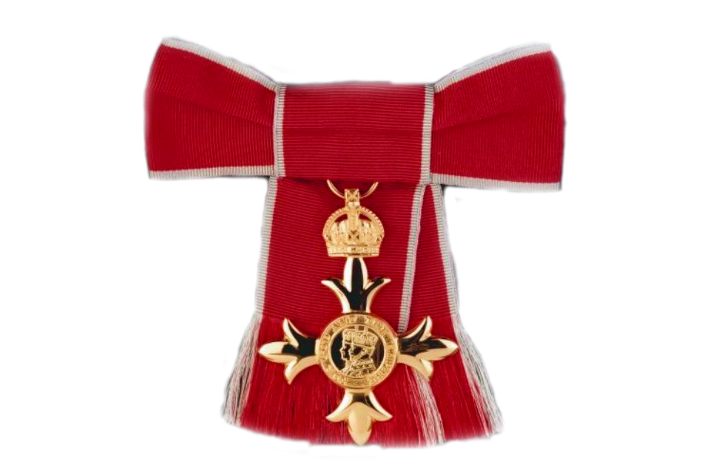
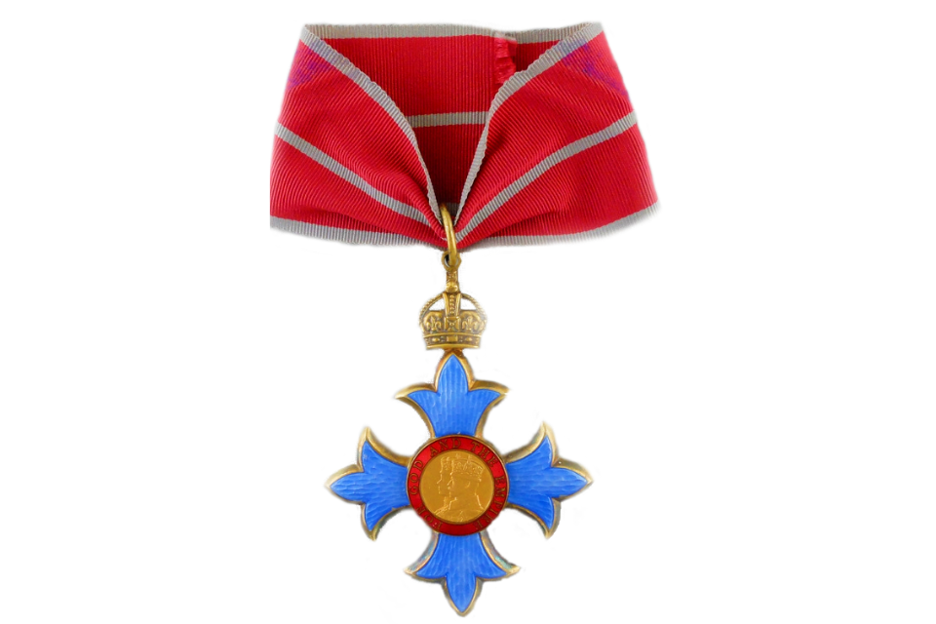
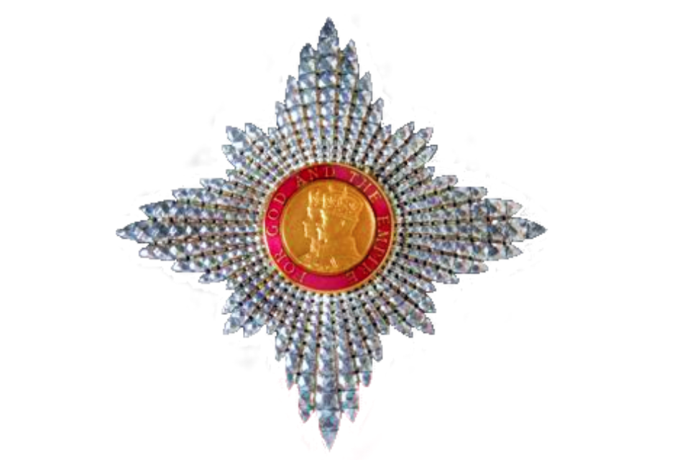
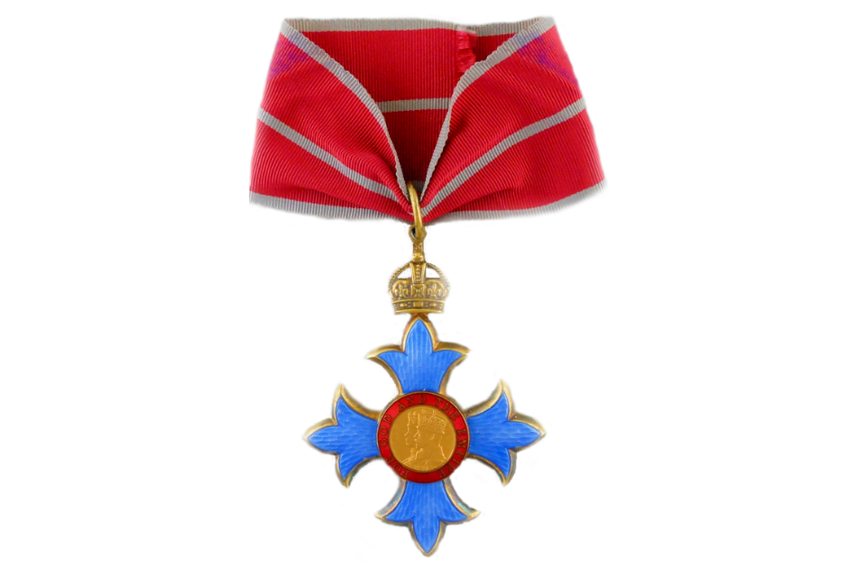
https://honours.cabinetoffice.gov.uk/
The Most Excellent Order of the British Empire
The main Order in use is The Most Excellent Order of the British Empire, these are the honours which are published twice a year. There are different levels of awards in the Order.
BEM
MBE
OBE
CBE
DBE / Kt

Slide 4
The Honours process
Notes:
Going to tell you a little bit about the Honours process, from beginning t o end.

Slide 5

Public nominations process
https://honours.cabinetoffice.gov.uk/
Public nominations made by the public
Nomination is sent to the relevant HM Government Dept
Nomination goes through checks and internal departmental sifts
Public Nominations
Successful nominations are submitted for the next round of committees
Local case is sent to Lord Lieutenant for validation and relevant departments for comments
Nomination goes to Cabinet Office internal sift
Lord Lieutenants nominations
Notes:
Once a nomination has been submitted….what happens?
Public nominations and Lord Lieutenants’ nominations are made to our Public Nominations team in Honours and then referred to the relevant department.
Cases which are primarily local in nature or do not fit neatly into a single departmental remit are considered by the Public Nominations team directly with input from relevant departments and the Lieutenancy for the county in which the nominee lives and/or works- these are referred to as “Run Central” cases.
Lord Lieutenant nominations are either run centrally or will be passed on to the relevant department to manage if the nominee has a specific specialism - though these nominations are seen as more urgent than general public nominations and they do hold more weight as they have been submitted by Lord Lieutenants.
Each department has its own internal sift committee which decides which cases go forward to the honours committees. We operate three sift committees- one that serves in this role of sifting our “Run Central” cases, Public Service committee sift as well as a CVS Sift Committee which helps reduce the number of nominations to be considered by the PS and CVS committees, which is the busiest of the ten honours committees. Both of these sift committees include Lord Lieutenants as voting members. Please get in touch with us if your Lord Lieutenant would be interested in sitting on one of these committees.

Slide 6







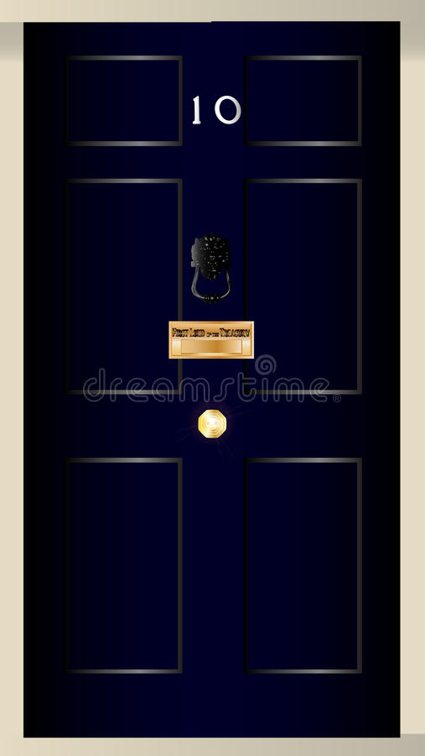







Honours process
https://honours.cabinetoffice.gov.uk/
Stakeholder suggestions
Public Nominations
Recommendations considered by main committee
Nominations considered by committees
Notes:
Once a nomination has been submitted….what happens?
Departmental nominations are made by selected stakeholders directly to the relevant dept, and public nominations and Lord Lieutenants’ nominations are made to our Public Nominations team in Honours and then referred to the relevant department. Cases which are primarily local in nature or do not fit neatly into a single departmental remit are considered by the Public Nominations team directly with input from relevant departments and the Lieutenancy for the county in which the nominee lives and/or works- these are referred to as “Run Central” cases. Your input is extremely useful to us not only to provide a perspective on any local work, but also to make us aware of any local issues that we may not be aware of, including how the nomination would be received locally.
The nominations are then sifted by the considering department or by the secretariat before the successful cases are sent to the committees for consideration. Each department has its own internal sift committee which decides which cases go forward to the honours committees. We operate two sift committees- one that serves in this role of sifting our “Run Central” cases, as well as a CVS Sift Committee which helps reduce the number of nominations to be considered by the CVS committee, which is the busiest of the ten honours committees. Both of these sift committees include Lord Lieutenants as voting members. Please get in touch with us if your Lord Lieutenant would be interested in sitting on one of these committees.
There are 10 independent committees, made up of independent voting members who are distinguished within the particular area covered by the committee, and non-voting official members who are senior civil servants from departments the committee covers.
The higher level recipients approved by the independent committees are then taken to the main committee, which is comprised of the chairs of each independent committee, as well as key high ranking officials (Cab Sec, Permanent Under Secretary from FCDO, Chief of Defence Staff) acting as official members, and chaired by Dame Sarah Healy. The list finalised by the honours committees is subjected to factual and probity checks and sent to the PM and then to HMK for approval. Once this approval has been given, the list is said to have informal approval.
Prospective recipients on this informal version of the list are then sounded to offer them a chance to accept or decline the award, as well as to affirm the accuracy of their details and of the Short Citation to be published. It is also at this stage that you will be informed of any successful candidates within your county.
The amended list then returns to the Prime Minister and His Majesty for formal approval, after which it is final and ready to be published in one of the two annual Honours Lists.

Slide 7
The independent committees
https://honours.cabinetoffice.gov.uk/
Arts & Media
State
Public Service
Parliamentary & Political Service
Education
Economy
Health and Social Care
Science, Technology & Research
Community & Voluntary Service
Sport

Slide 8
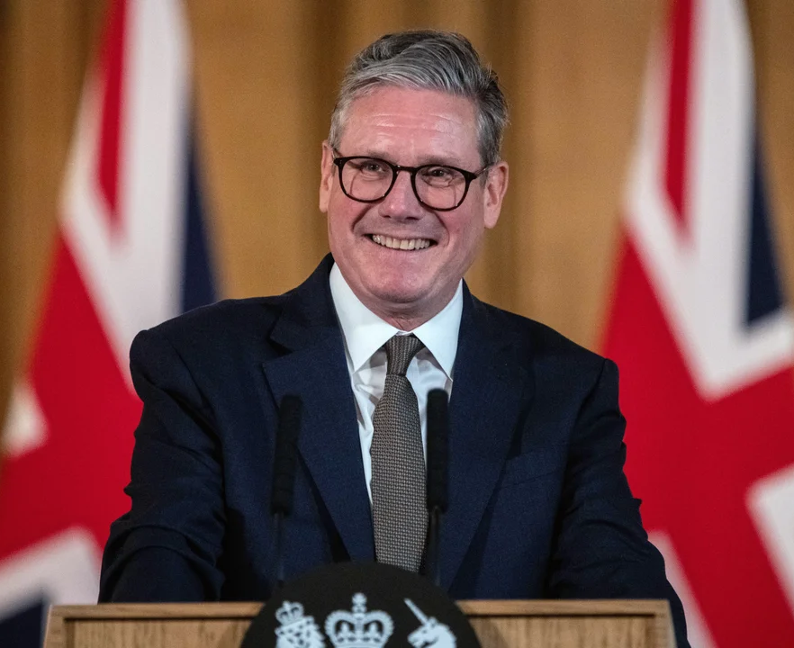
https://honours.cabinetoffice.gov.uk/
Prime Minister’s priorities
The Prime Minister would like to see the honours system be properly reflective of UK society. There should be representation from the length and breadth of the country and all sections of society, reflecting the incredible contributions made across every part of the United Kingdom.
The Prime Minister would like to see more recipients from underrepresented communities and would like to see further variety in the types of work rewarded. The honours system should also seek to reward individuals in all stages of life, young and old.
The Prime Minister supports nominations for those going above and beyond to deliver positive change for their communities. Honours should not be automatic or assumed due to a job or position an individual holds, unless it can be demonstrated that there has been action beyond the call of duty. Awards for local champions should be prioritised, in addition to those that have shown real delivery and an impact to citizens through their actions to better the lives of others, driven forward national renewal, and secured our future as a society.
Notes:
We have the PM’s priorities which are our guide for future rounds - the PM has made it clear that he wants people awarded based on merit - the honours system should be diverse and reflective of UK society and that regionality is important, we want representation from all over the country.
The PM is looking for more diverse nominations from underrepresented communities and this doesn’t just mean ethnicity but we will cover more of that later on!

Slide 9
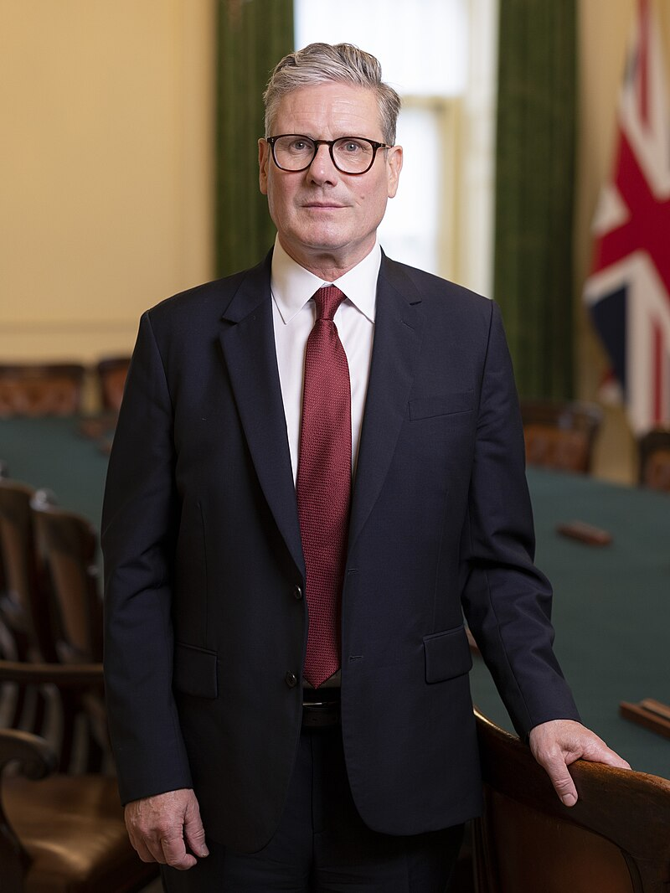
https://honours.cabinetoffice.gov.uk/
Prime Minister’s priorities
In addition, the Prime Minister would like to see the honours system especially recognise:
Those working to deliver and reinforce the Strong Foundations of the UK through economic stability, national security, and border security.
Those working to Kickstart Economic Growth, delivering economic stability, and increasing productivity in every part of the country, to make everyone better off.
Those working to Rebuild Britain, working to deliver a transformational 1.5 million homes, and building the infrastructure this country needs.
Health professionals working to build an NHS fit for the future, reducing waiting times and ensuring fewer lives lost to the biggest killers.
Those working to ensure Safer Streets, preventing and addressing crime, such as violence against women and girls and knife crime, and improving their communities.
Those working to Break Down Barriers to Opportunity by ensuring children have the best start in life, and that, regardless of background, they can go on to achieve throughout school and in their careers.
Those working to Make Britain a Clean Energy Superpower, by delivering clean and renewable energy, addressing climate change, and helping the UK accelerate to Net Zero.

Slide 10
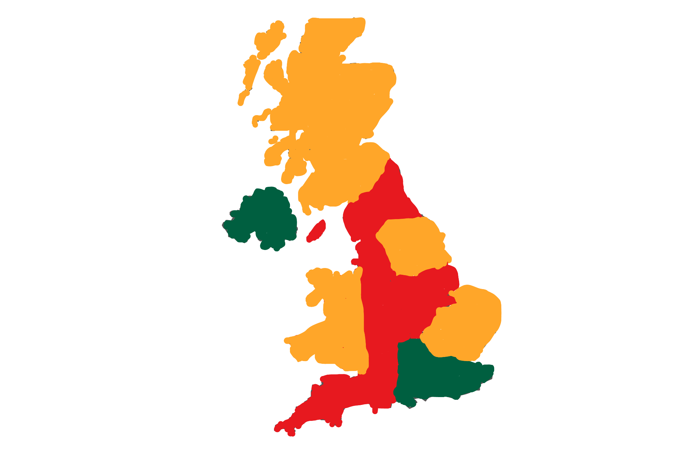
https://honours.cabinetoffice.gov.uk/
Diversity in the Honours System
Women at all levels
Minority ethnic groups at all levels
People with disabilities at all levels
LGBTQ+ at all levels
Younger people
Lower socioeconomic backgrounds
People who live outside of London
Notes:
We want bigger representation across the country - but regionality is just one of the areas of diversity that we want to target.
We want to diversify nominations from as many protected characteristics as possible and get nominations in for young people that are doing amazing things.
We want to see people making a difference from all walks of life recognised for their brilliant work and at all levels.
Both Lisa and Jennie are also members of our honours Diversity and Outreach Committee Committee and can give you a little more detail on their work in this area.

Slide 11
Honours in Cornwall

Slide 12
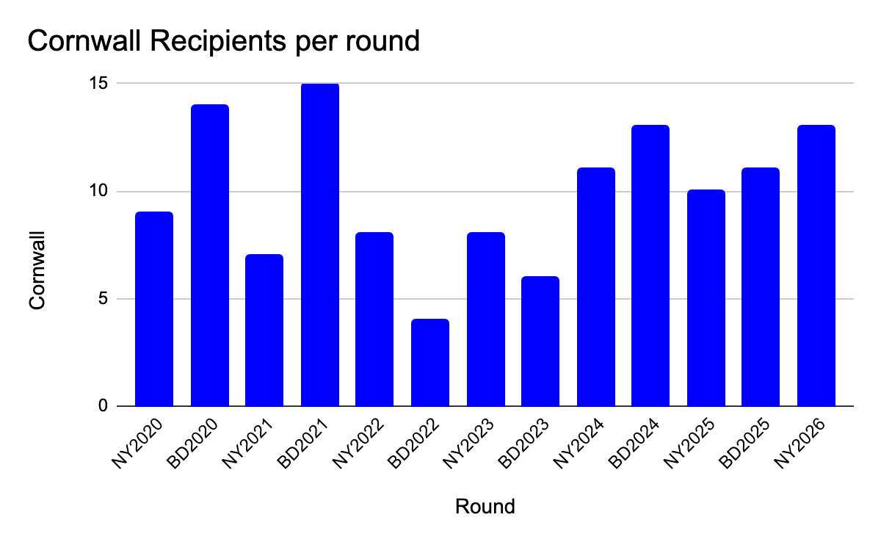
https://honours.cabinetoffice.gov.uk/
Cornwall Data 2020-2026
Notes:
Data for Cornwall - increasing over the past 3 rounds, but we still need more nominations

Slide 13
https://honours.cabinetoffice.gov.uk/
How can you help/mythbusting
Encourage nominations for outstanding candidates.
Identify gaps: who’s missing from recent lists?
Anyone can make a nomination on gov.uk
Over 1100 people are awarded in every honours list (two a year)
Only a small percentage of recipients are ‘celebrities’ or high profile public figures.
Notes:
What can you do to help?
Encourage nominations
Anyone can make a nomination on gov.uk
Over 1100 people are awarded in every honours list (two a year)
Only a small percentage of recipients are ‘celebrities’ or high profile public figures - majority arepeople who are doing great things in the community

Slide 14
https://honours.cabinetoffice.gov.uk/
A great opportunity for Cornwall
Honours are a wonderful encouragement
  To individuals
  To organisations or businesses
  To communities
  To the region

Slide 15
Writing a strong citation

Slide 16
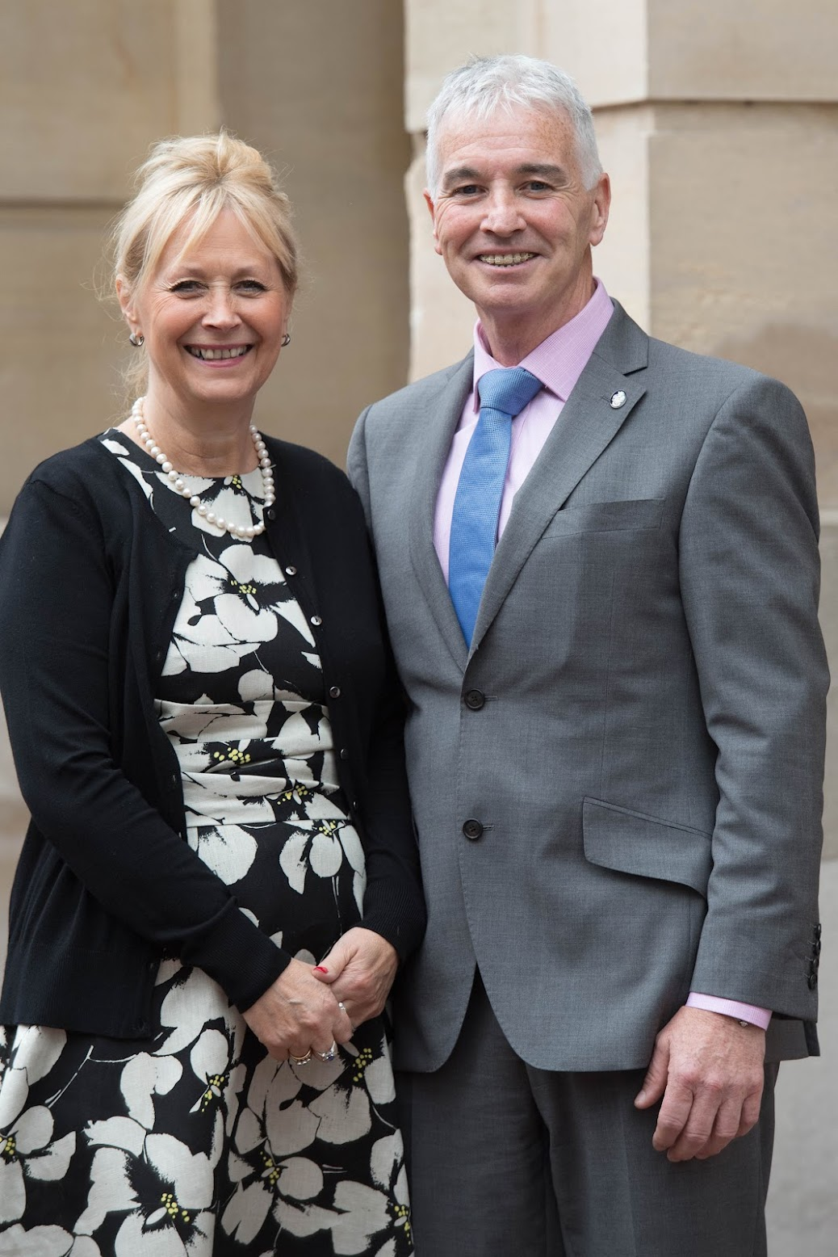
https://honours.cabinetoffice.gov.uk/
Who gets honoured?
How have they gone above and beyond?
Why have they done this work - why was there a need?
What voluntary work / individual initiatives have they led? What has been the impact of their work?
What’s the geographical reach of their work?
Is this timely?
Is everything you’ve included full, factual and accurate?
Notes:
There are three important things to include in your nomination - it’s what sets your nominee apart from others:
Above and beyond
Significant contributions
Positive impact
Have they gone above and beyond- especially significant in paid work, where there is a higher standard to show that the candidate has gone beyond what’s expected of them in their paid role.
Geographical reach- even small scale local work can be recognised by a national honour, but the geographical reach of the work is particularly helpful in determining the appropriate level of award.
Timeliness- in most cases, only work that is current or recently concluded can be considered. It is helpful to provide details of a nominee’s past work as part of a picture of their career, and past activities can be considered if their work in that field is ongoing. In general, the focus of the nomination should be on the last five years of the nominee’s work.

Slide 17
https://honours.cabinetoffice.gov.uk/
Some persuasive extracts
“She has devoted most of her spare time to running a social club for elderly people with learning difficulties, even though she is in full time employment. Over the past 5 years, more than 200 people have benefited.”
“Although in full time work with local government, he gives up two evenings a week and all day Sunday to helping in the hospice. He has both managed their very complex finances and helped on the front line. He has done this consistently over the last 32 years.”

Slide 18

https://honours.cabinetoffice.gov.uk/
Commons pitfalls
The citation lists roles (like a CV) but doesn’t describe the nominee’s impact
The achievements or activities are too old
There’s no evidence of tangible achievement or change
The citation is poorly written or confusing to someone who isn’t an expert in the field
The claims of the citation are inaccurate
The citation isn’t long enough: most citations won’t make a convincing case in less than the full page of writing
Notes:
Really easy to list everything a person has done in the area they are being nominated for, but this doesn't give evidence or explain the great things they've achieved or tell someone that knows nothing about the person what makes the things they've done deserving of an honour

Slide 19
https://honours.cabinetoffice.gov.uk/
Top tips for writing a nomination
What works well….
Use 2-3 recent examples
Don’t use jargon (or acronyms)
Tell their story
What works less well…
Dated nomination
Lacks impact
Nomination reads as CV
No evidence
Notes:
It can be really easy to forget that the person reading the nomination won’t know the nominee - you the citation needs to tell the story of the person you are nominating and its important to explain everything instead of using acronyms - and whilst it’s tempting to throw everything into the citation, keep it focused on 2-3 impactful things that this person has done, let this add the majority of the flavour.
If the citation says the person has achieved something or has had impact on something - explain what it is….back it up with evidence.
The nomination needs to sing to the reader!

Slide 20
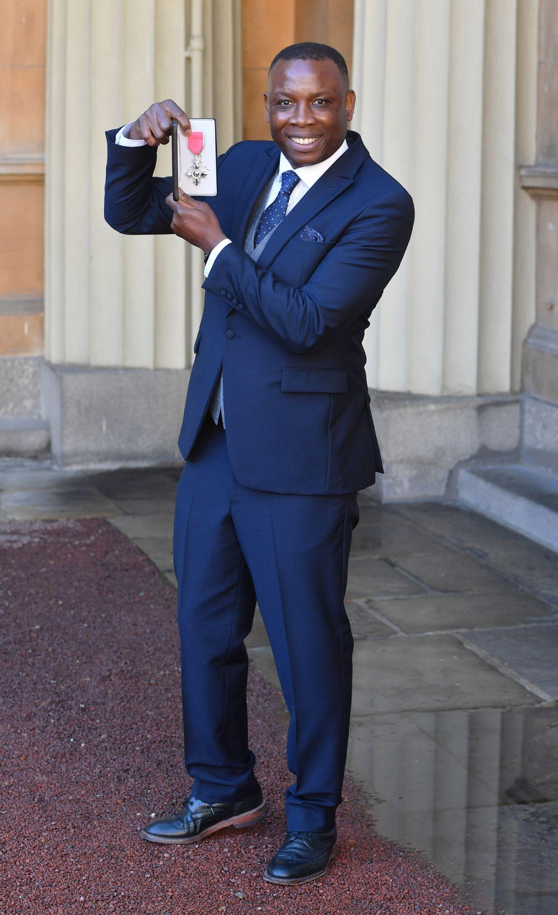
https://honours.cabinetoffice.gov.uk/
Nomination checklist
Start and finish with a strong sentence
Ask yourself “is this really relevant?” (remove if not)
Highlight the individual’s achievement(s) and the impact
Start with the most recent & important achievement(s)
Check that all the information is factual & up-to-date
Include stats, facts & figures, outcomes and evidence
Notes:
I can’t emphasise the importance of :
stats,
facts,
Figures
evidence enough - this is what validates the citation, it demonstrates exactly what the person has achieved and how it has had impact.

Slide 21
Questions

Slide 22
Thank you
Contact details:
Anica Khan - anica.khan@cabinetoffice.gov.uk
Honours - honours@cabinetoffice.gov.uk
Minal Vachheta - minal.vachheta1@cabinetoffice.gov.uk
Nicki Daniels - nicki.daniels@cabinetoffice.gov.uk

